Slide 1
Website Graphics
Website Graphics
Photo – Adobe Stock
Notes:
Photo of 3 screen sizes responsive design
a good example of how content should scale across screens. Easy to read

Slide 2
Website Graphics
2.0 Website Graphics
2.1 Identify the main components of the photo editing, vector, and prototyping software.
2.2 Explain how each tool is used to create and edit images.
2.3 Create simple shapes and original graphics.

Slide 3
Website Graphics (cont’d)
2.0 Website Graphics
2.1 Identify the main components of the photo editing, vector, and prototyping software.
We will explore the AI, PSD Apps and the tools, control panels, and learn to navigate around the application
And we will look combine shapes and make a collage, composite image and a logo.

Slide 4
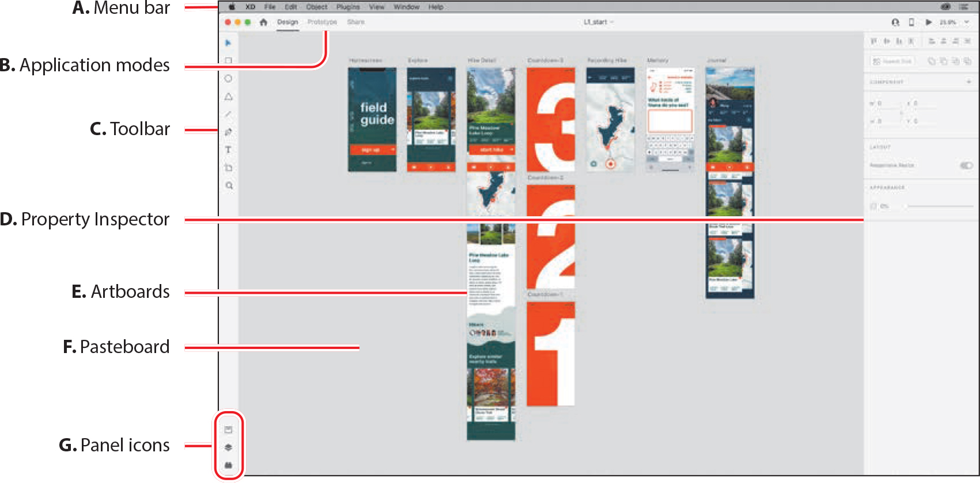
XD App UI Components

Slide 5
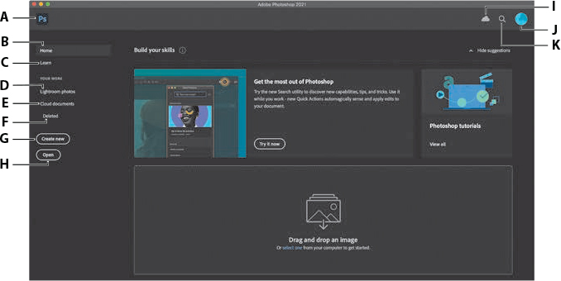
PSD App UI Components

Slide 6
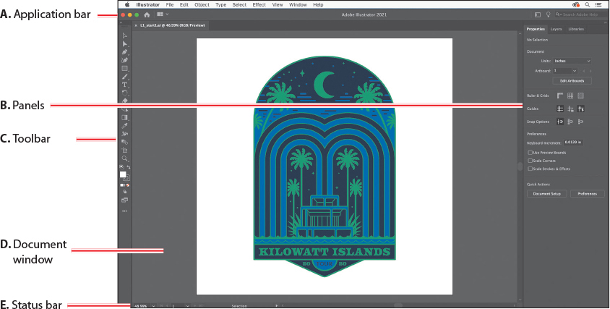
AI App UI Components

